Slide 1

Human VALUES
The principles that everyone should follow to live a happy and positive life

Slide 2

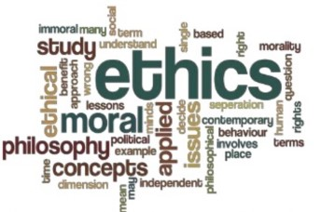
Human Values
Human values are virtues that guide us to take into account human element when one interacts with other human beings. They are our feelings for the human essence of others.
It’s both what we expect others to do to us and what we aim to give to other human beings. These human values give the effect of bonding, comforting and reassuring.
Human values include honesty, trustworthiness, diligence, discipline, fairness, love, peace, justice, empathy and stewardship of the environment.

Slide 3
Human Values
SOCIAL VALUES
MORAL VALUES
ETHICAL VALUES
AESTHETIC VALUE
PROFESSIONAL VALUE

Slide 4

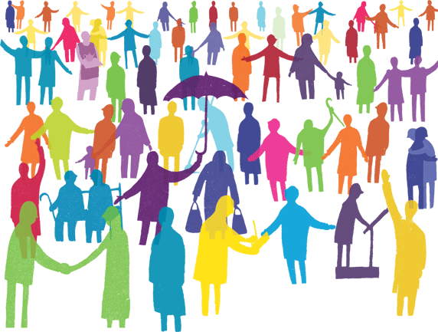
Social Value
Social values form an important part of the culture of the society. Values account for the stability of social order.
They provide the general guidelines for social conduct. Values such as fundamental rights, patriotism, respect for human dignity, rationality, sacrifice, individuality, equality, democracy etc. guide our behavior in many ways.
Values are the criteria people use in assessing their daily lives; arrange their priorities and choosing between alternative course of action.

Slide 5

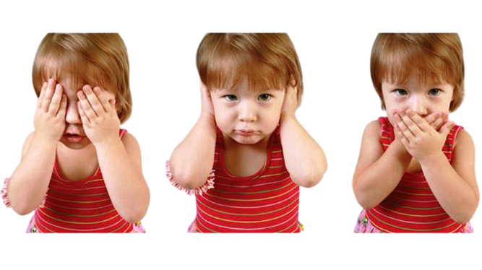
Moral Value
Some of the Moral values includes...
Respect. Many parents make the mistake of teaching their children only about respect for elders, but that is wrong.
Family. Family is an integral part of kids' lives.
Adjusting and Compromising.
Helping Mentality.
Respecting Religion.
Justice.
Honesty.

Slide 6


Ethical Value
“The regard that something is held to deserve; the importance, worth, or usefulness of something.”
Ethical values are the ones we make ethical choices based on them, or they are the kind of values that have to do with being good or doing the right thing.
Ethical values have the most important role in our life. Imagine you have a house and you know that two month later, the value of your house will dramatically increase and it will be the best time to sell your house. But there is a problem. Your father is ill and has to have an emergency operation and you have no money. Economic value persuades you to don’t sell the house until two month later, but ethical values force you to sell the house as soon as possible.

Slide 7

Aesthetic Value
Aesthetic. It refers to Art, the Fine Arts and the Performing Arts.
Just don't stare at people who achieved something that guy did something you haven't or may be something you can't, help him do more.
Aesthetic value is the value that an object, event or state of affairs (most paradigmatically an art work or the natural environment) possesses in virtue of its capacity to elicit pleasure(positive value) or displeasure (negative value) when appreciated or experienced aesthetically.

Slide 8
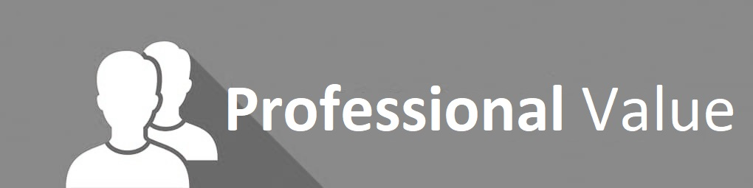
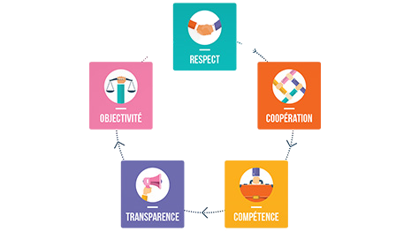
Professional Values
Professional values are the guiding beliefs and principles that influence your work behaviour.
Integrity, Continuous Learning, Responsibility, Accountability and Team work.
No matter the career one chooses, the values and ethical standards instilled as a youth will guide one’s professional decisions, good or bad. Most corporations, companies or associations have a written set of values or ethical guidelines by which all are held accountable.

Slide 9
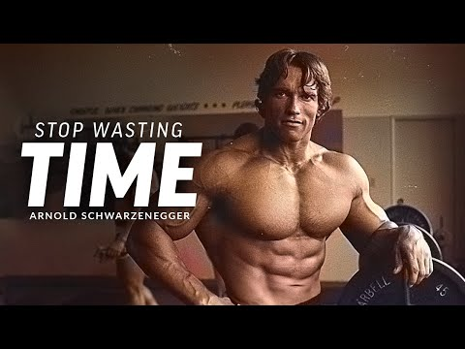
Time

Slide 10


